Slide 1
Data Analysis Iris exercises 1 & 2
Week 3: Classification - Iris
Ronald Fokkink
08-03-2022

Slide 2
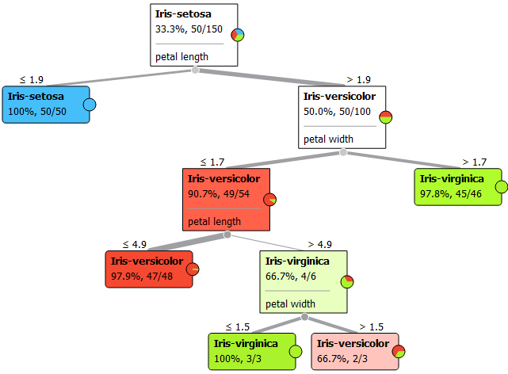
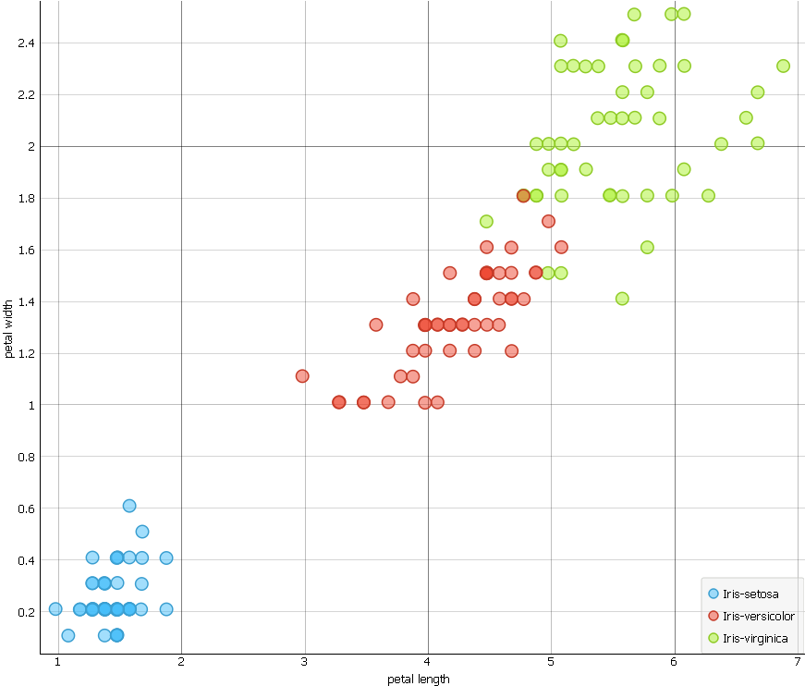
Exercise 1 - Tree
1
2
4
2
3
1
3
4

Slide 3
Exercise 2
Which types of classifiers do we find in Orange:
Logistic regression linear true probabilistic
Naive Bayes linear true probabilistic
SVM linear also regression
Stochastic Gradient Descent linear idem
Tree idem
kNN non-probabilistic idem
Random Forest idem ensemble
Ada Boost idem ensemble
Gradient Boosting idem ensemble
Neural Network not in Orange?
Which type classifier is Naïve Bayes:
linear classifier: linear decision boundary
probabilistic classifier: creates a probabilistic model
What is the function of the confusion matrix:
relates predicted classes to actual classes
shows the ways in which your classification model is confused when it makes predictions
function: to assess predictive accuracy of a model

Slide 4
Exercise 2 – Naive Bayes & Trees
To answer questions 4 to 9, we performed 4 runs for building a Naive Bayes model and 2 Trees using a random training set with 105 observations and a test set with the remaining 45 observations.
The minimum number of observations per leaf is set to 2 and 15 respectively.
The number of observations in the test set that were correctly classified by each model is shown in the following table.
For both trees, the number of correctly classified observations in the training set is shown in brackets.
Also, the number leaves are shown.
Run | Naive Bayes | Tree (min. 2 obs./leave) | Instances) | Tree (min. 15 obs./leave) | Instances)
 | correct | correct | leaves | correct | leaves
1 | 36 | 44 (104) | 7 | 44 (100) | 4
2 | 42 | 43 (104) | 7 | 42 (102) | 4
3 | 42 | 43 (104) | 7 | 42 (102) | 4
4 | 44 | 41 (103) | 5 | 41 (102) | 3

Slide 5
Exercise 2
How much items are correctly classified in the first run: see 6
Do another run with Naive Bayes but now as an unpruned set
How much item are now correctly classified:
In 4 runs, the number of observations correctly classified ranges from 36 to 44.
This high variance is surprising as Naive Bayes is considered a high bias/low variance classifier.
Visualize the decision tree of the first run: see sheet 6.
Minimize the leaves of the decision tree (change the ‘min. instances per leave ‘ in 15)
Visualize the decision tree of the third run (sheet 7). What is the difference of these two decision trees:
In 4 runs, both trees have nearly identical accuracy on the test set, although the tree with a minimum of 15 observations per leaf is usually smaller.
In these runs, he accuracy on the training set is higher than the accuracy on the test set, as expected.
Comparing the accuracy on the training set, the tree with a minimum of 2 observations per leaf has higher accuracy, which is an indication for overfitting.

Slide 6
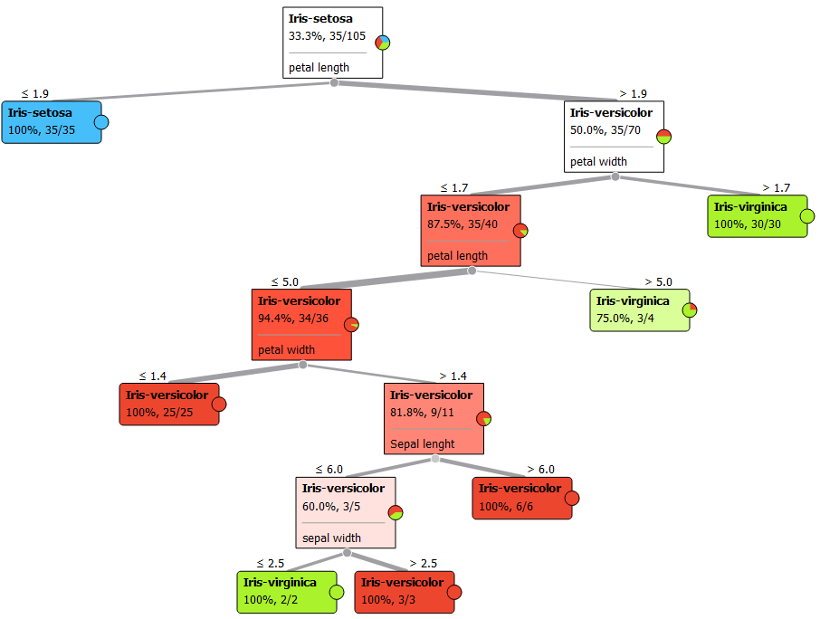
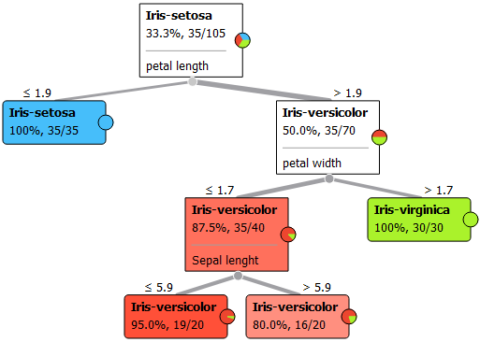
Exercise 2 – Both trees run 1

Slide 7
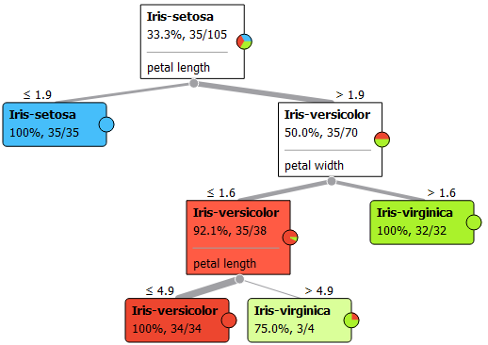
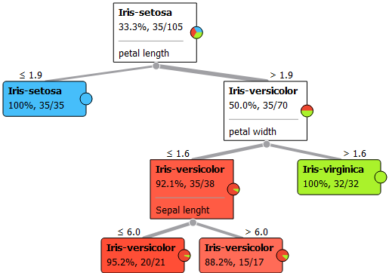
Exercise 2 – Both trees run 3

